Slide 1
3rd Semester Masters Control and Automation
Jeppe Jensen & Mathias Frederiksen C4-204

Slide 2
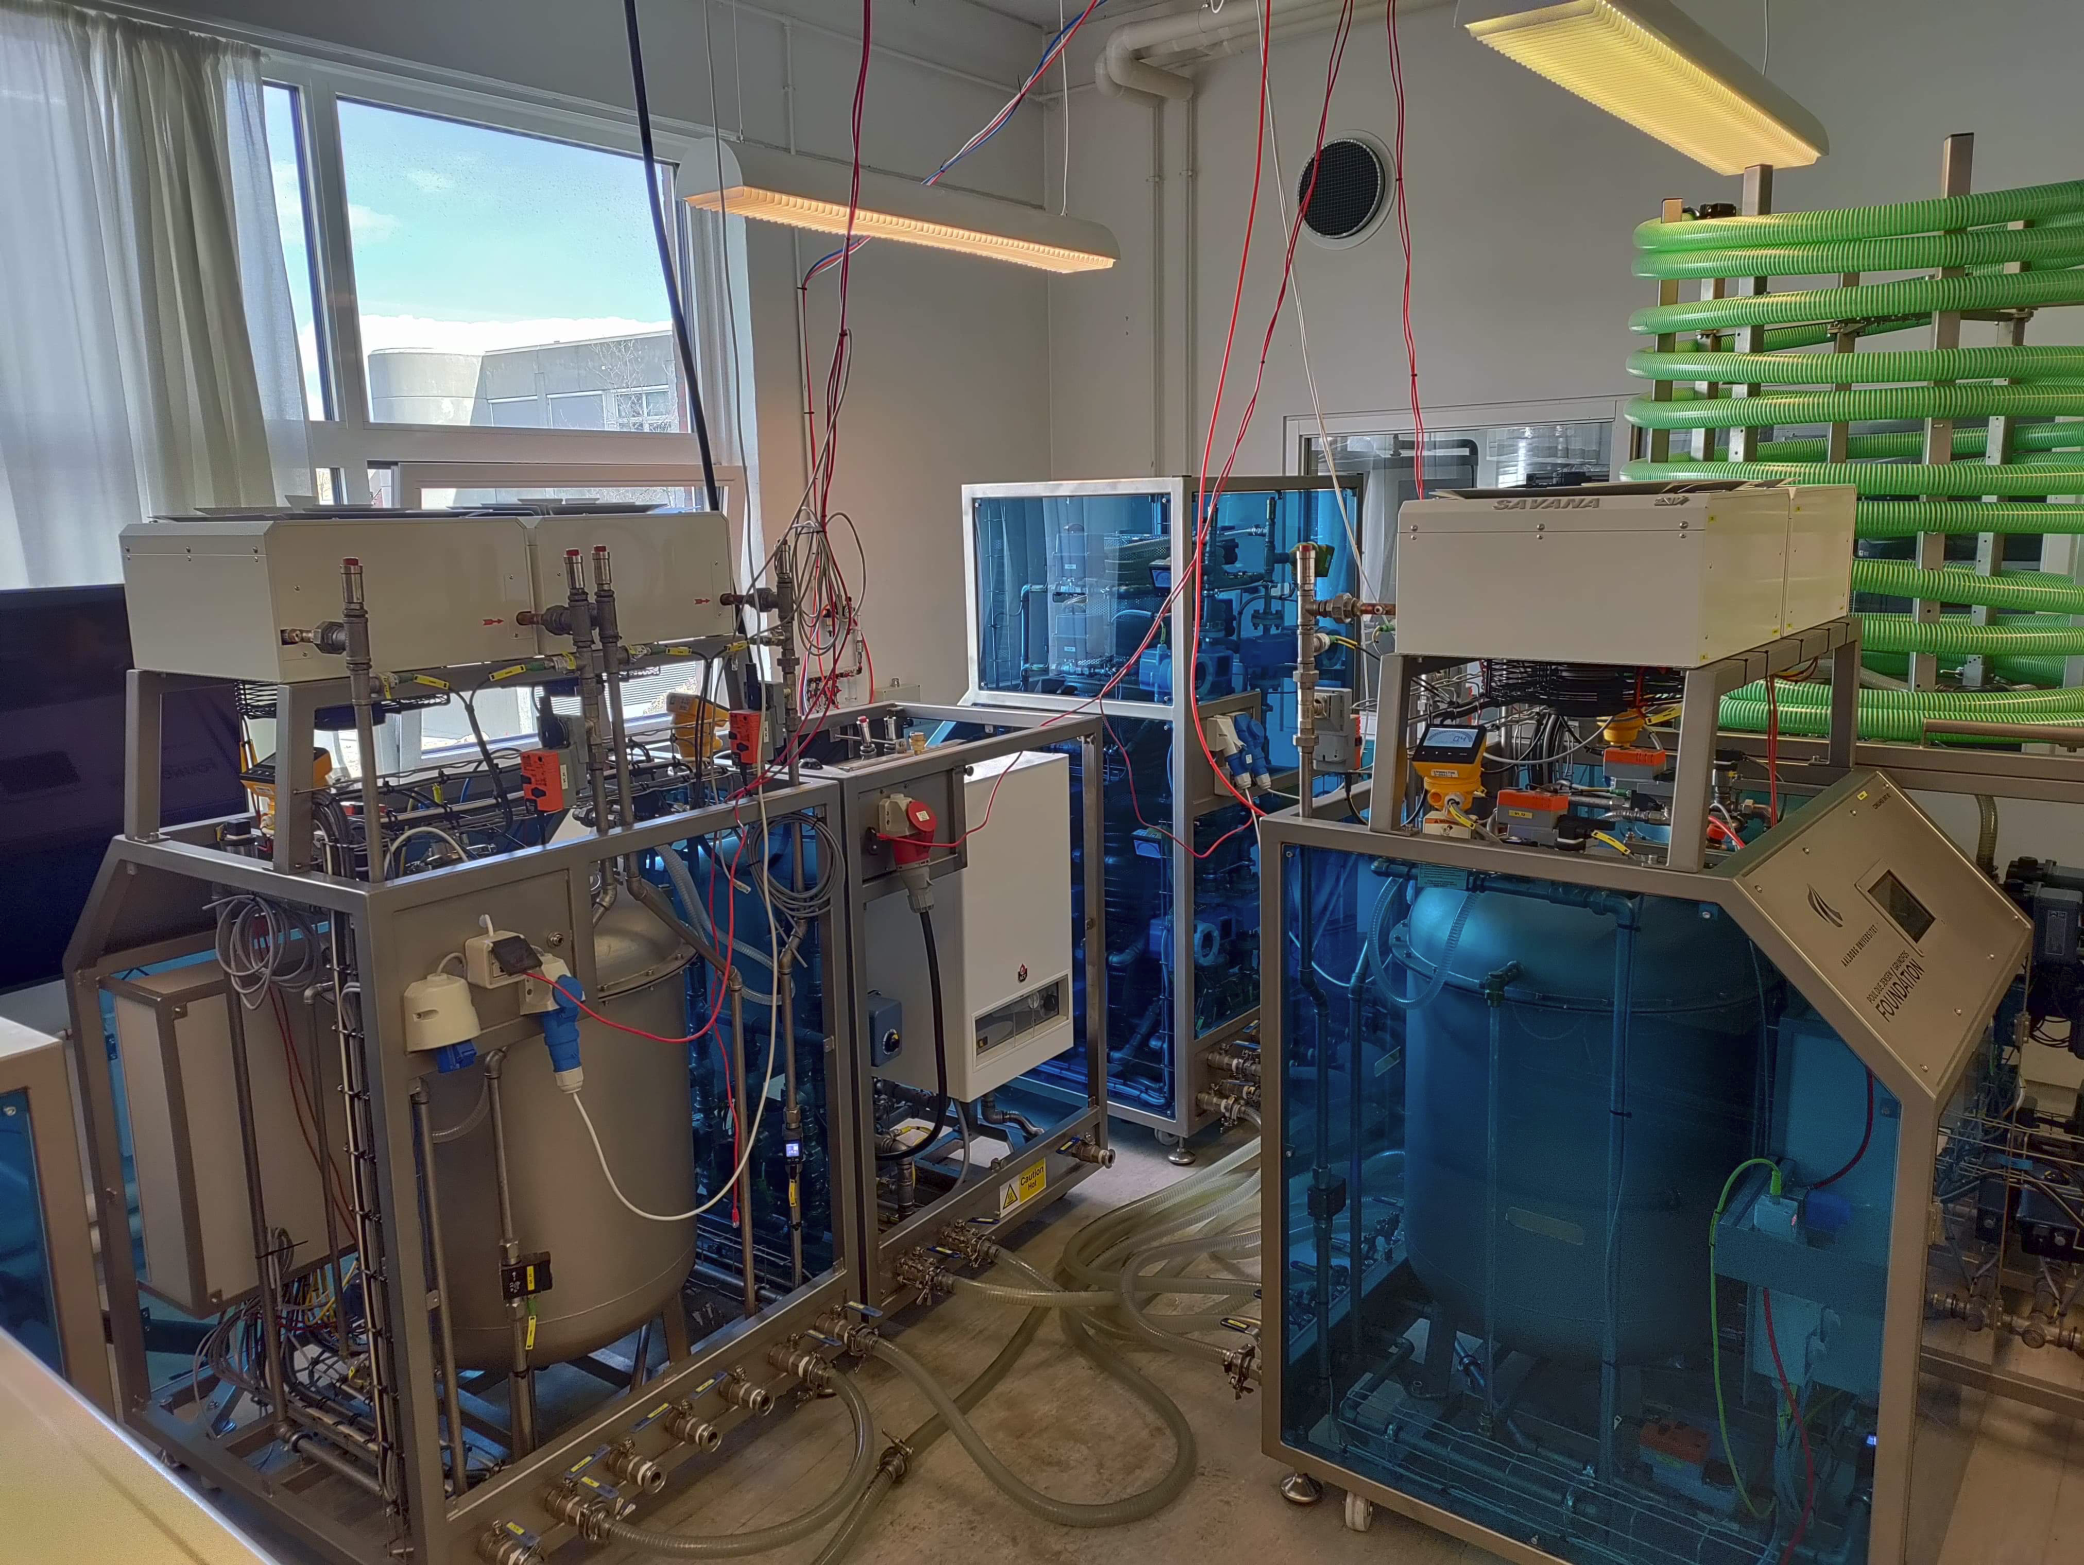
laboratory
Modular laboratories
Configure to suit various projects
Components include:
Pumps, Pipes, Valves, Heating modules, cooling modules and elevated water reservoirs

Slide 3
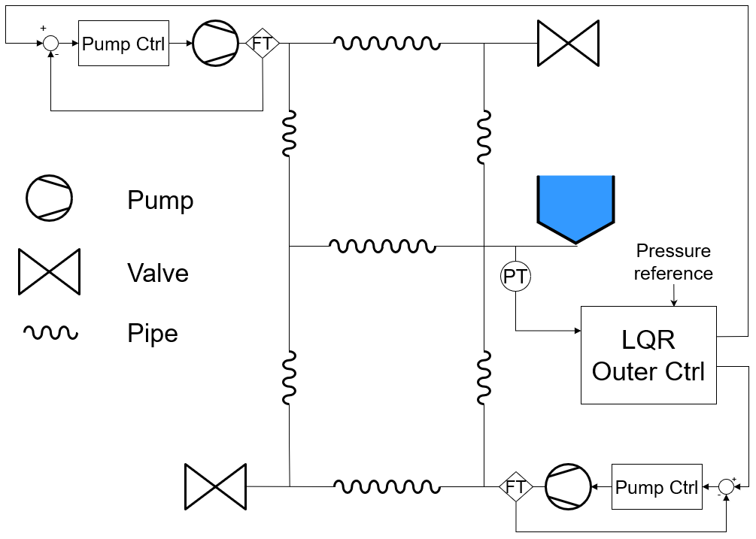
Modeling and control of water distribution network
Goal:
Pressure Control in EVR
Leakage detection
Method:
Model based on Graph theory
Components:
Pumps, pipes, valves, EVR

Slide 4
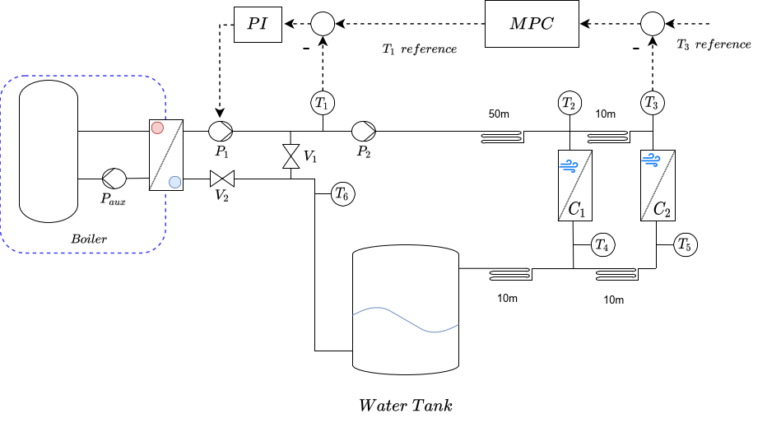
Modelling and Control of District heating system
Goal:
Supply district heating to consumers
Difficulties:
Delay in heat transport
Heat loss in pipes

Slide 5
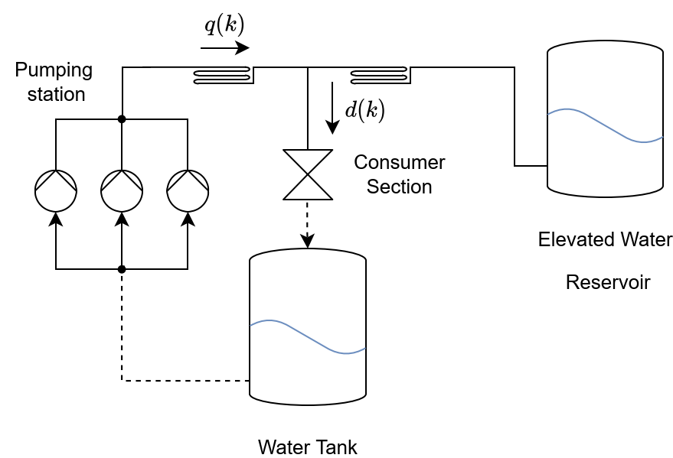
Model-free control of WDN
Goal
Develop Model-free control method
Method
RL based control of WDN
Cost function to self-evaluate
Tabular vs Generalisation (Approximation)
Difficulties
Hyper-parameters
Convergence time and optimal convergence

